Slide 1
Going Viral
Uncovering Key Drivers in Content Virality Through Data Analysis
Team Members:
Toya Okey-Nwamara, Kruthi Kannajoshyula, Emily Santacruz Garcia, Melissa Rivera-Franco, Tatiana Pope, and Natalia Herrera
Notes:
tatiana

Slide 2
Table of Contents
01
Problem Statement
02
Modeling
03
Evaluation
04
Storytelling & Impact
Introduction, data source, and methodology
Pre-Processing and modeling
Models’ performance evaluation
Review on insights gained and impact
Notes:
tatiana

Slide 3
01
Problem
Statement
Notes:
tatiana

Slide 4
The Introduction
Social media plays a huge role in how we communicate and share content.
Some posts go viral—what makes them stand out?
We explore this using a Kaggle dataset with 5,000 posts across TikTok, Instagram, Twitter, and YouTube.
Data includes views, likes, shares, hashtags, post type, and engagement level.
Our goal: Identify key features that predict whether a post will go viral.
Useful for content creators, marketers, and trend analysts.
Notes:
kruthi

Slide 5
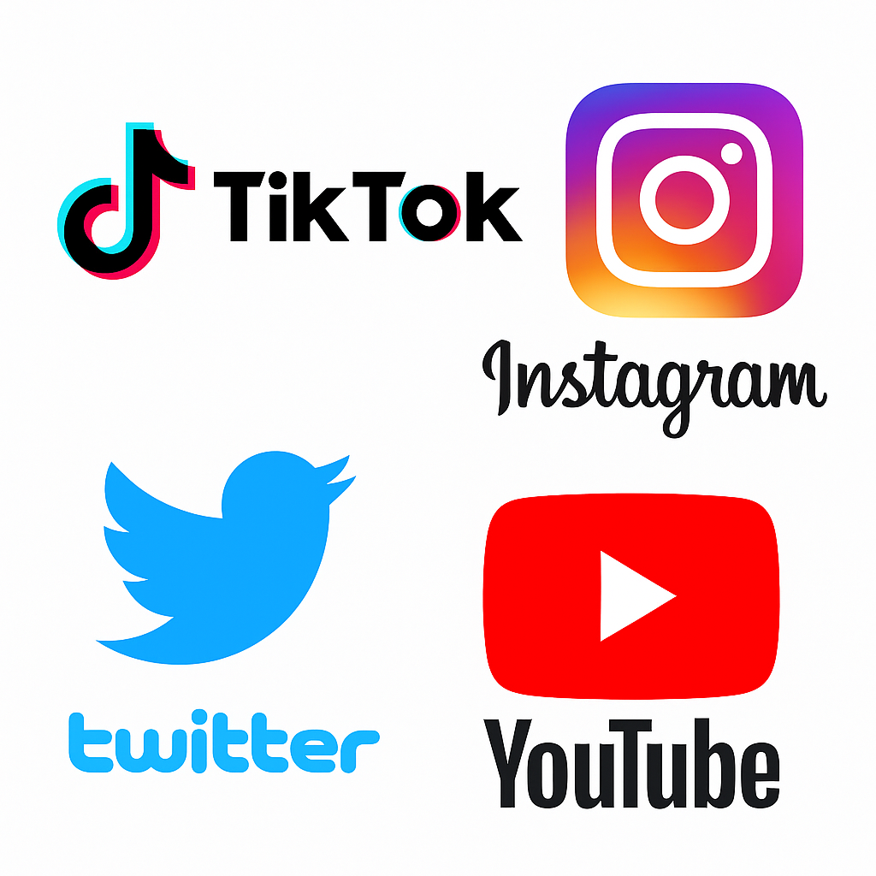
Our Data
Dataset: "Viral Social Media Trends & Engagement Analysis" from Kaggle
Size: 5,000 social media posts
Platforms: TikTok, Instagram, Twitter, YouTube
Features Included:
  Platform, Hashtag, Content Type (e.g. video, reel)
  Region, Views, Likes, Shares, Comments
  Engagement Level: Low, Medium, High (used for classification)
Youtube had the most posts
Livestreams & standard posts were the most common
Engagement levels were evenly distributed
Notes:
kruthi

Slide 6
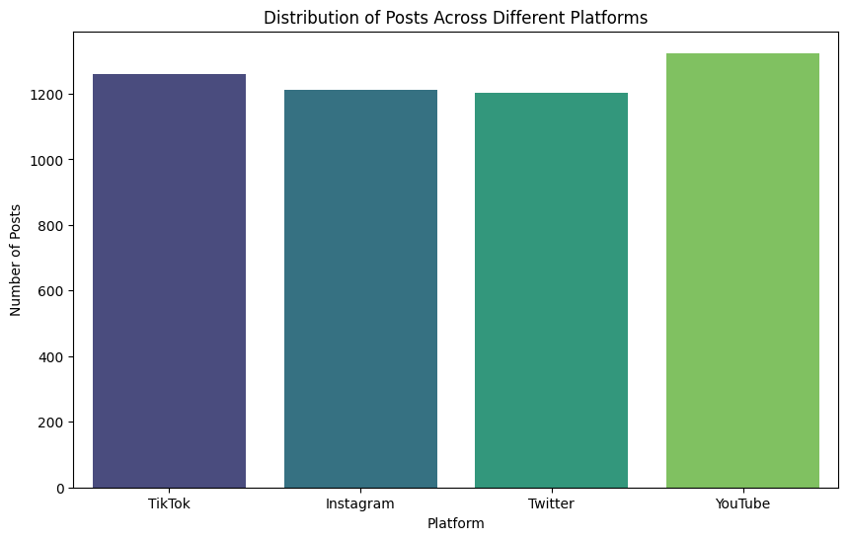
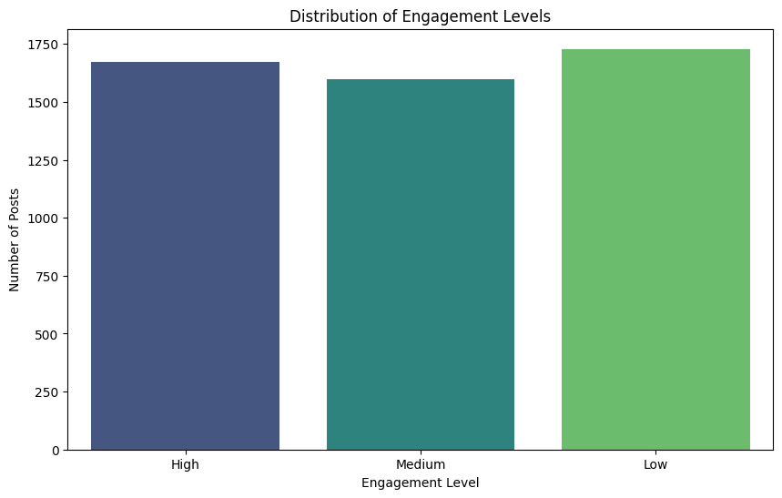
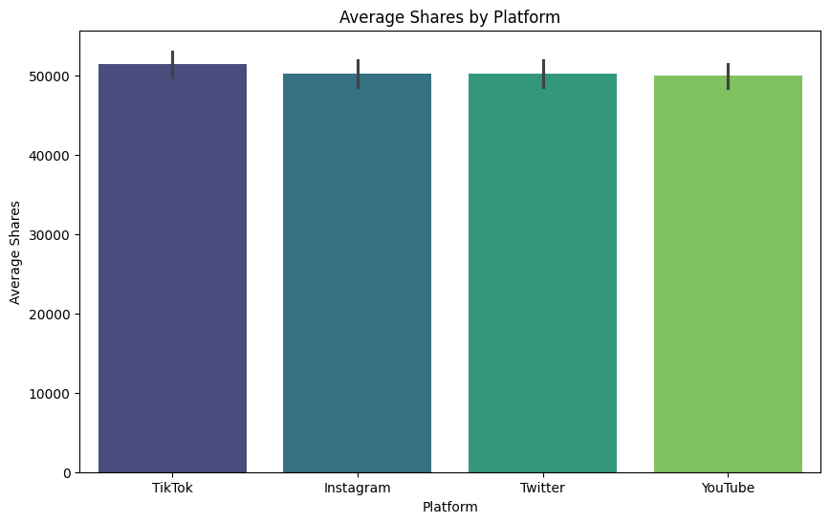
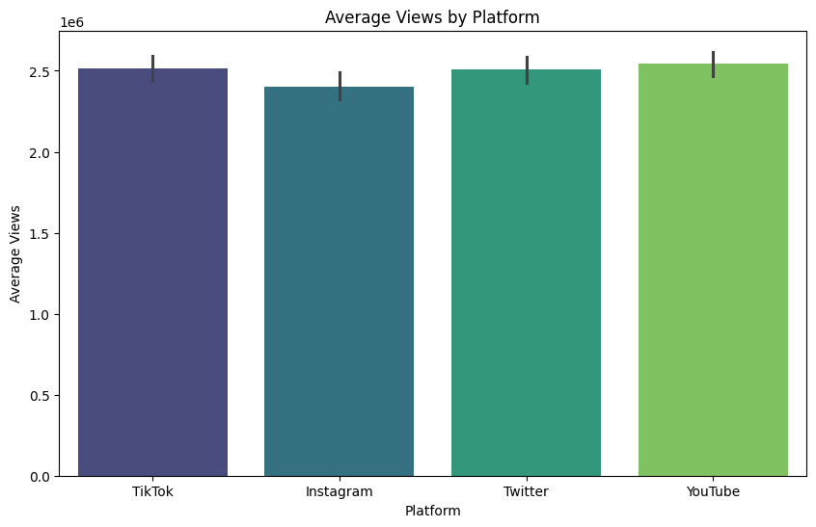
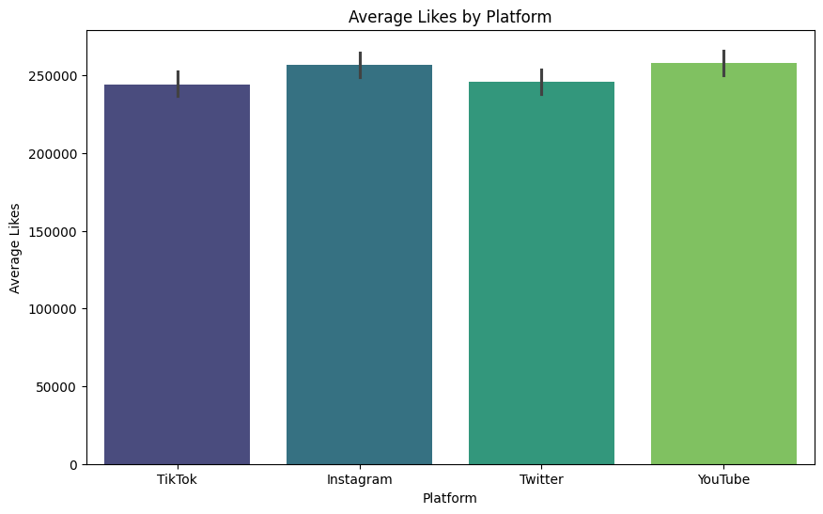
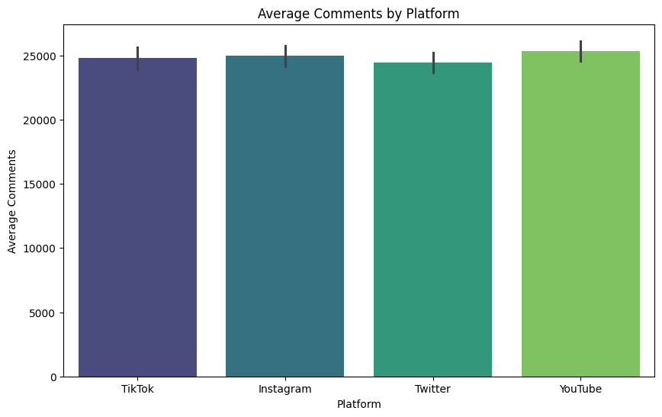
Data Visualizations
Notes:
kruthi

Slide 7
02
Modeling
Notes:
melissa

Slide 8
Pre-Processing Steps
One-Hot Encoding
Target Variable Transformation
Categorical columns converted them into binary vectors
We transformed the target variable 'Engagement_Level' from text labels into numeric
Data Inspection
Dropping Irrelevant Columns
Final Dataset Structure
We inspected the dataset using the info() function and confirmed
- no missing values
- 6/10 columns were categorical.
We then dropped the 'Post_ID' column, as it served only as a unique identifier and had no predictive value."
Our dataset expanded from 10 to 29 columns, making it fully numeric and ready for input into machine learning models
Notes:
melissa

Slide 9
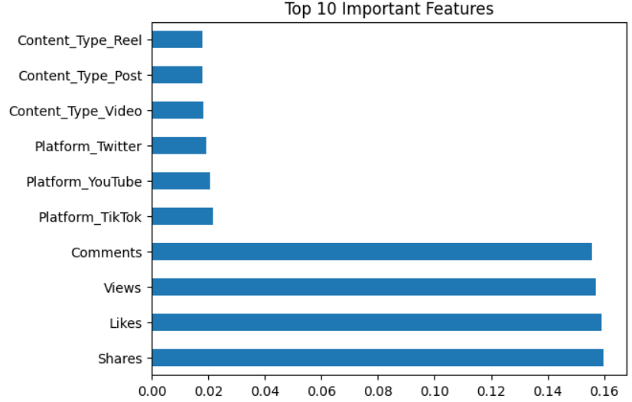
Classification Predicting Engagement Level
Separated features (X) from the target variable (y) by dropping the Engagement_Level column.
Used a Random Forest Classifier, which builds multiple decision trees and merges them for more accurate and stable predictions.
Proposed creating new features that reflect ratios or relationships, such as interactions per view, to better capture engagement patterns.
Accuracy Range: 0.319-0.33
Notes:
melissa

Slide 10
New Feature Engineering: Engagement Rate
Created a new feature called Engagement_Rate, calculated as:
(Likes+Shares+Comments)/Views
This feature captures how interactions relate to visibility, offering a normalized view of post engagement.
Repeated data preparation by separating features (X) and target (y), now including the new Engagement_Rate feature.
- By including Engagement_Rate, we aimed to improve the model’s ability to detect high-engagement posts more precisely.
Anticipated a shift in feature importance, where Engagement Rate may emerge as a key predictor.
Accuracy Range: 0.32-0.36
Notes:
melissa

Slide 11
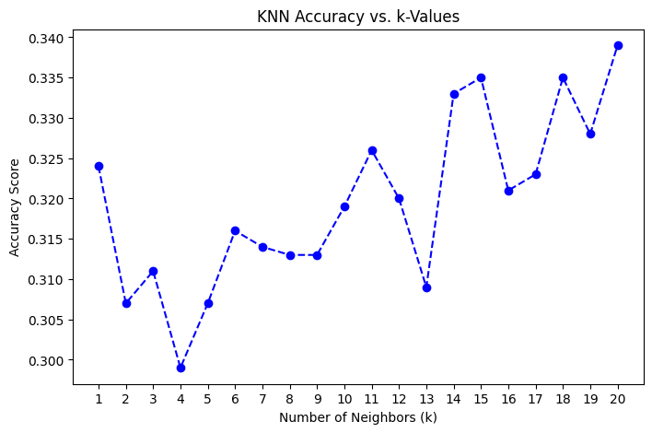
KNN
Why KNN
  Chosen for simplicity and interpretability
  Does not assume any data distribution
  Supports multiclass classification which helps multiple engagement levels
How it works
  Uses 5 nearest neighbors to classify based on features similarities
  Model trained on 80% data, 20% testing
Insight
  Provided an initial benchmark for how well classification can perform
Notes:
toya

Slide 12
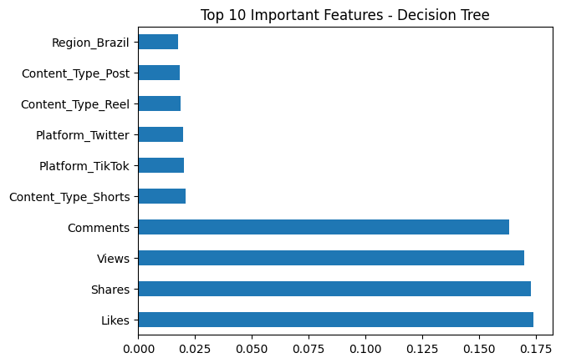
Decision Tree
Why Decision Tree?
  High interpretability
  Splits data into meaningful categories
  Reveals most influential features
How it works
  Trained on same dataset as KNN
  Predicts engagement level by learning hierarchical decision rules
Insight
  Main contributors
    Views, Shares, Comments, and Likes
Notes:
toya

Slide 13
03
Evaluation
Notes:
natalia

Slide 14
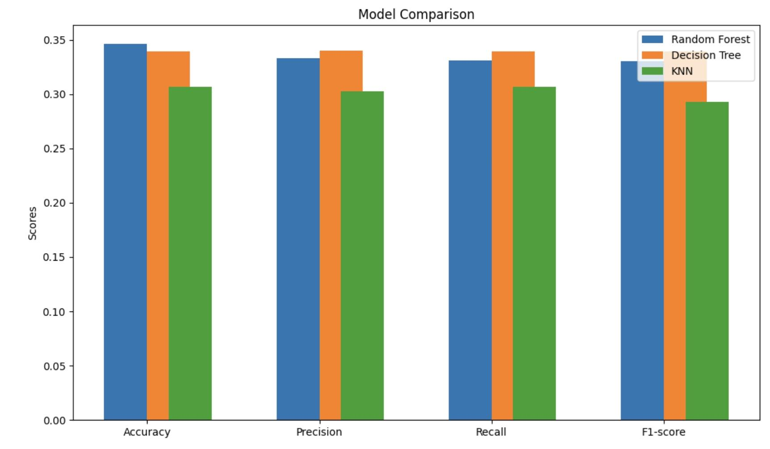
Performance Comparison of Models
Goal:
  Assess how well models predict engagement level (low, medium, high)
  Use evaluation metrics to measure success
Metrics Used: Accuracy, Precision, Recall, F1-score
Model Comparison:
  Random Forest performed best (~0.36 accuracy after feature engineering)
  Decision Tree followed closely (~0.35 accuracy)
  KNN had lowest accuracy (~0.307)

Slide 15
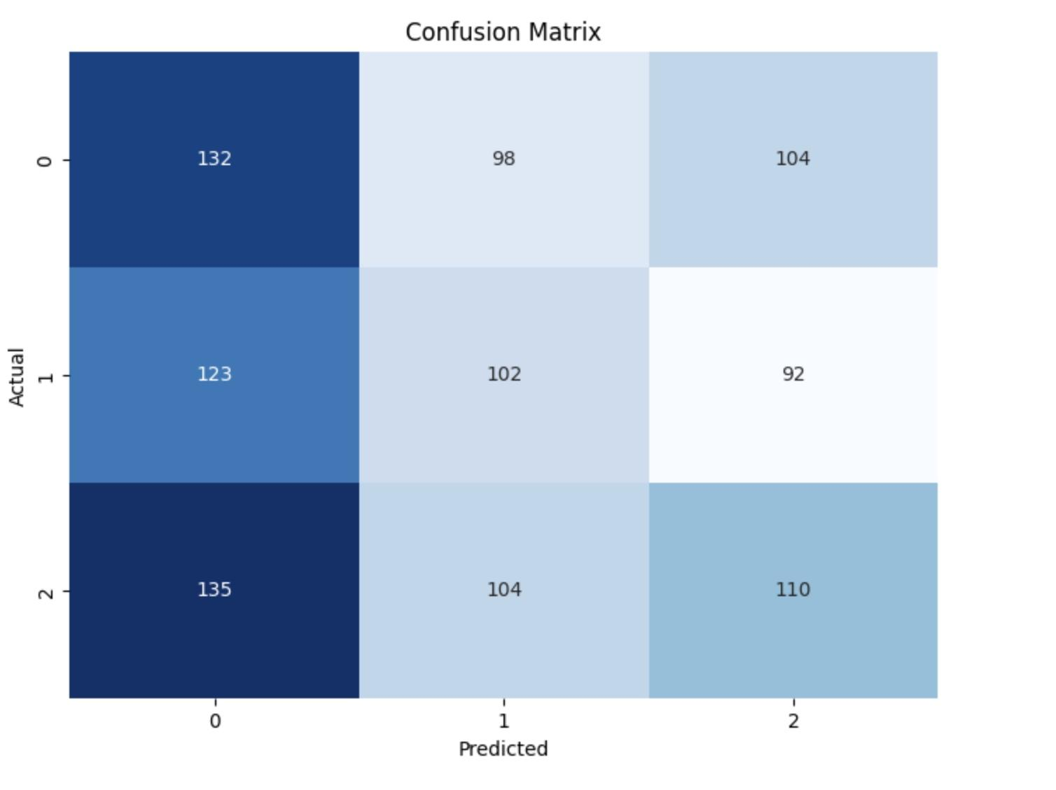
Feature Engineering & Challenges
Impact of Feature Engineering:
  Engagement_Rate improved Random Forest classification slightly
  Feature scaling could benefit KNN
  Some features influenced classification more than others
Challenges Identified:
  Confusion matrix shows difficulty distinguishing medium vs. high engagement
  Low engagement posts were easier to classify
  Model struggles suggest external factors influence virality
Random Forest - Post Feature Engineering
Notes:
To refine our model predictions, we introduced feature engineering, specifically the Engagement_Rate feature—calculated by summing likes, shares, and comments and dividing by views. This helped slightly improve classification accuracy, particularly for the Random Forest model. -
Random Forest Evaluation = 0.331
Random Forest - Post Feature Engineering = 0.346
However, as the confusion matrix reveals, medium and high engagement levels remain difficult to classify. The overlapping characteristics between these categories make precise predictions challenging. On the other hand, low engagement posts were identified more accurately, showing that less viral content follows more distinguishable trends.
Ultimately, while our models partially predict social media virality, further refinements—such as integrating text-based insights and platform-specific trends—could enhance classification accuracy in future iterations.

Slide 16
04
Storytelling & Impact
Notes:
emily

Slide 17
Data Storytelling
Can virality be predicted?
We tested AI models on social data — and found out it's way more chaotic than it looks.
Shares outperform views and content types.
Engagement Rate uncovers hidden patterns
Predicting low engagement is straightforward.
High engagement = messy, unpredictable, vibes-driven
Cultural relevance drives higher engagement levels.
Timing and vibes significantly influence engagement.
Notes:
Emily: Can we predict what goes viral? To find out, we tested advanced AI models on a large dataset from social media. Our results showed that virality is more complex and chaotic than we expected.
We discovered important insights: shares are more effective than views and content type in predicting success. Engagement rates revealed patterns that people often miss. It was relatively easy to predict low engagement levels, but high engagement levels were much harder to predict and messy.
Two key factors drove engagement: cultural relevance boosts engagement, and timing is crucial for reach and impact. In conclusion, while data can help us see trends and possible outcomes, virality remains partly unpredictable. It is influenced by measurable metrics and changing cultural forces.

Slide 18
Main Takeaways
In summary…
Virality depends on culture and timing.
Low engagement is easier to forecast.
Shares indicate virality better than views.
User actions matter more than content.
Feature engineering boosts model performance significantly.
Notes:
emily
Virality is unpredictable - culture, timing, and trends matter more than algorithms can grasp
Low engagement is easier to predict; medium vs. high is way messier
Shares are the strongest indicator of virality - people spreading content matters most
Content type and platform are surprisingly less important than direct user actions
Smart feature engineering (like Engagement Rate) can boost model performance more than just switching algorithms

Slide 19
Impact
Potential Risks of Data-Driven Content Creation
Balancing Strategy with Ethical and Creative Integrity
Optimizes Social Media Engagement through Insights
Relying too heavily on engagement metrics may lead to manipulative, low-quality, or misleading content, diminishing creativity and authenticity online
The project analyzes the patterns behind viral posts, offering creators valuable guidance on how content characteristics influence engagement across platforms
While data can enhance content performance, it's important to maintain ethical standards and originality to foster a healthier digital environment
Notes:
Tatiana

Slide 20
Our Conclusion
Key Insights: We identified important factors like likes, shares, comments, and views that influence post engagement
Model Performance: Random Forest performed best, though accuracy was not that great. It highlighted the complexity of predicting medium and high engagement posts.
Takeaways: Predicting virality is hard, but the project provided valuable insights into social media trends
Notes:
kruthi

Slide 21
Thanks!
Please keep this slide for attribution
Notes:
kruthi

